Slide 1

Car Rental Management System
BY –
MADHUR JAISWAL
DEVANSHI SHARMA
ADITYA PANDEY
SECTION – T17
03096202719
02196202719
02496201719

Slide 2
INDEX
Abstract
Problem statement
Introduction
Flowchart and diagrams
Screenshots
Work done
Advantages
shortcomings

Slide 3
ABSTRACT
Car Rental System is based on a concept to rent cars and generate a rental invoice of a rental company. Before stepping into the main system a user has to pass through a login system to get access, then only the user can select cars with a different model and rent for certain days. This mini project contains limited features, but the essential one.
Talking about the features of the Car Rental System, after logging in as a user he/she has to provide a name then the user can select available cars. After selecting a car, the system displays selected car details which contain maximum power, mileage, and many more. Then the user has to provide information such as Car number and number of days to rent the car. After all these procedures, the system calculates rent and displays Customer Invoice presenting invoice number, customer’s name, car model, number, number of days, and total rental amount.
Car Rental system is developed using JAVA Programming Language and different variables, strings have been used for the development of it.

Slide 4
PROBLEM STATEMENT
The aim of our project is to create a Java Application which enables the administrator of to:
1. Add/Delete/Edit Cars and its details
2. Add/Delete/Edit Customers and their details
3. Add/Delete/Edit Car Bookings and its details

Slide 5
INTRODUCTION
Car Rental System is based on a concept to rent cars and generate a rental invoice of a rental company. Before stepping into the main system a user has to pass through a login system to get access, then only the user can select cars with a different model and rent for certain days. This mini project contains limited features, but the essential one.
Talking about the features of the Car Rental System, after logging in as a user he/she has to provide a name then the user can select available cars. After selecting a car, the system displays selected car details which contain maximum power, mileage, and many more. Then the user has to provide information such as Car number and number of days to rent the car. After all these procedures, the system calculates rent and displays Customer Invoice presenting invoice number, customer’s name, car model, number, number of days, and total rental amount.
Car Rental system is developed using JAVA Programming Language and different variables, strings have been used for the development of it.

Slide 6
INTRODUCTION
The main objective of the JAVA Project on the Car Rental System is to manage the details of Cars, Passenger Information's, Drivers, Car Bookings, and Invoices. It manages all the information about Cars, Car Routes and the time of rental. The project is totally built at the administrative end and thus only the administrator is guaranteed access. The purpose of the project is to build an application program to reduce the manual work for managing the Cars, Passenger Information's, Car Routes, Drivers, etc.

Slide 7
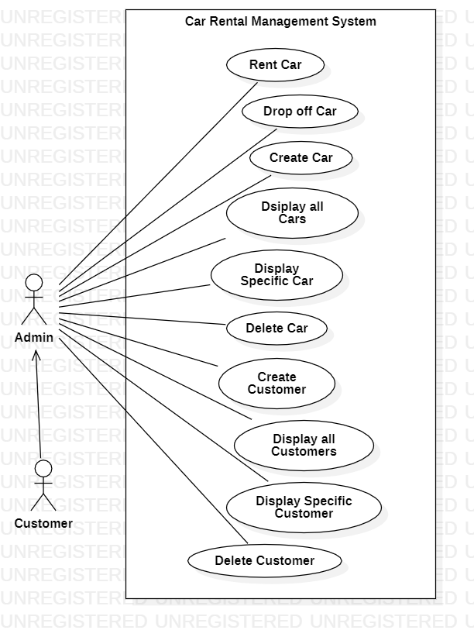
USE C­ASE DIAGRAM

Slide 8
Screenshots of project functioning and outputs

Slide 9
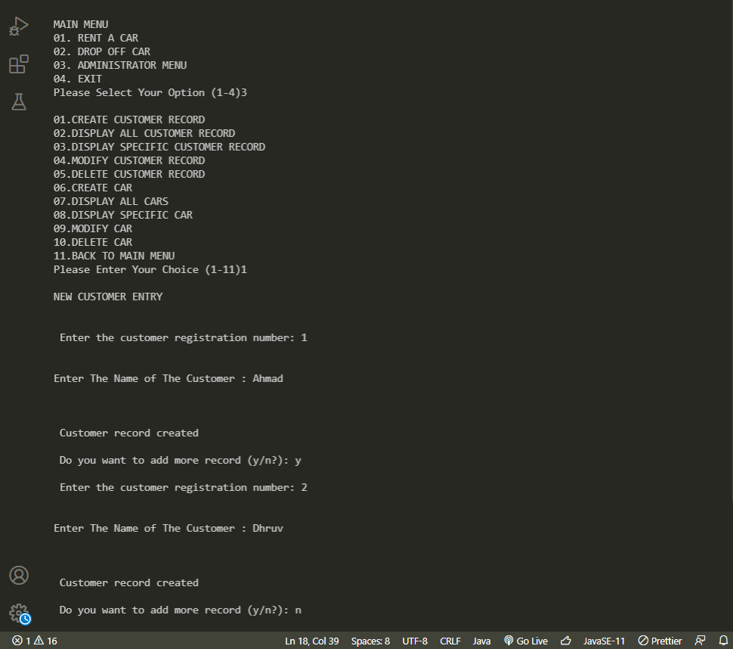

Slide 10
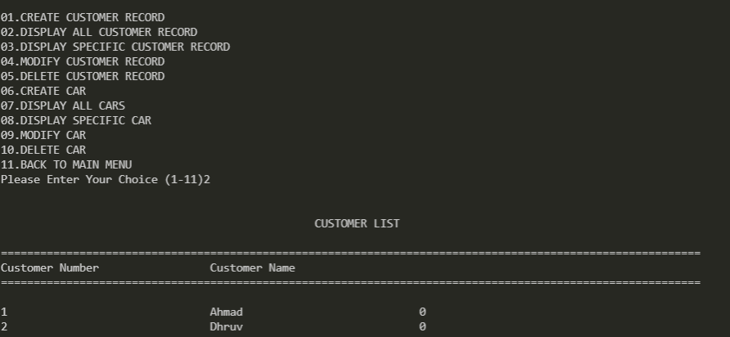

Slide 11
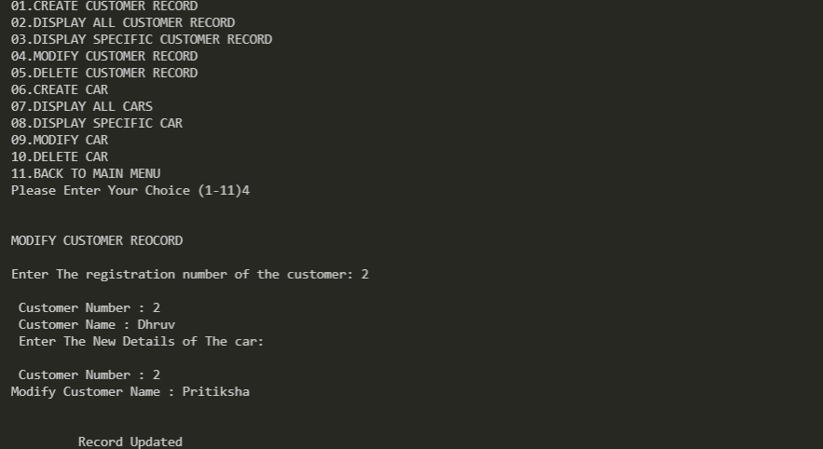

Slide 12
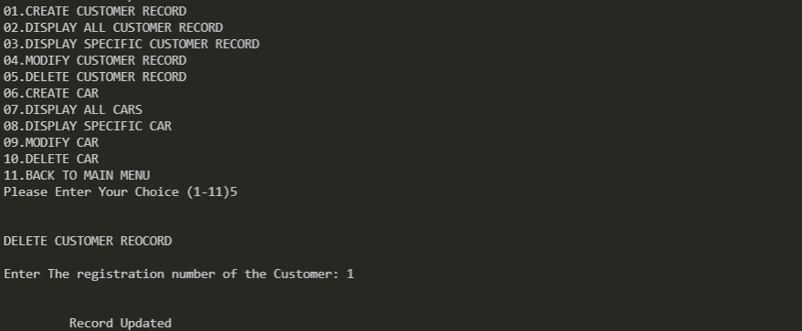

Slide 13
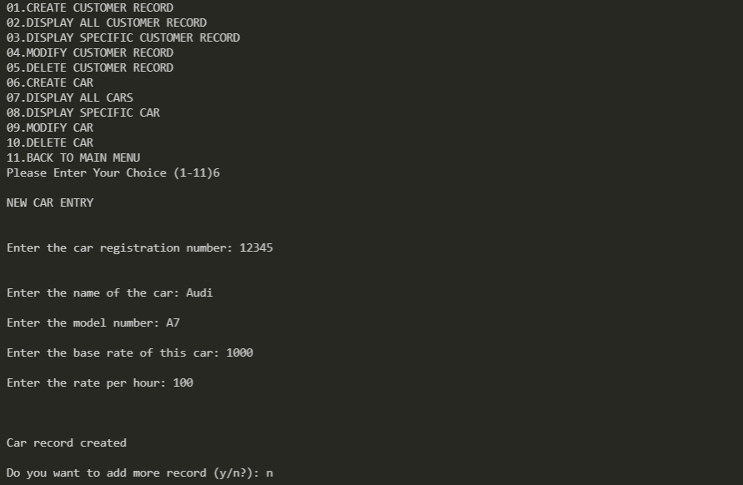

Slide 14
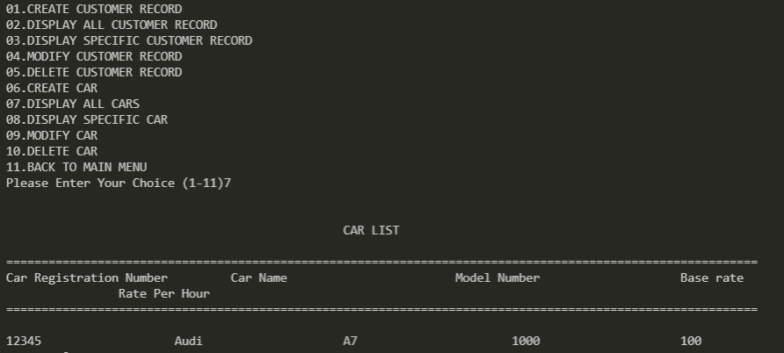

Slide 15
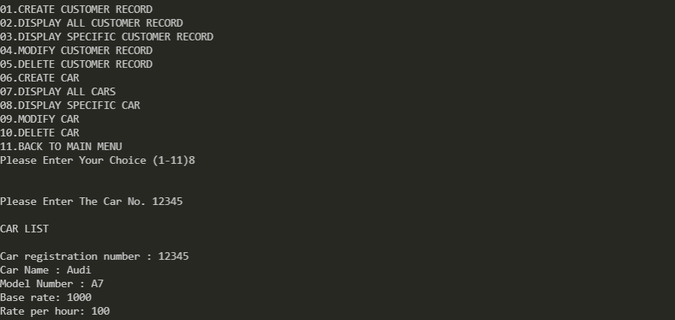

Slide 16
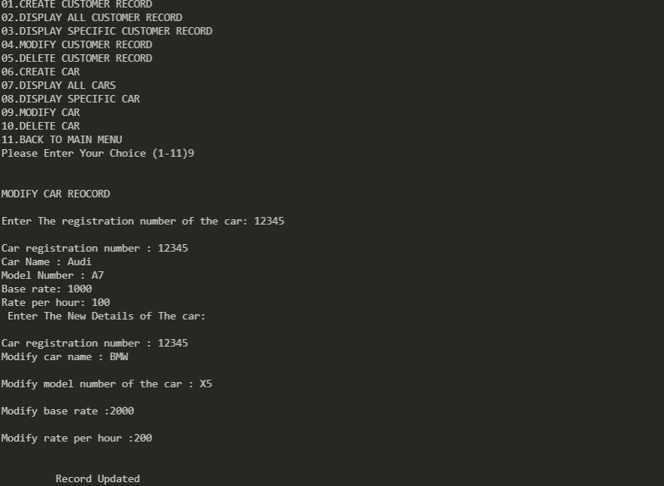

Slide 17
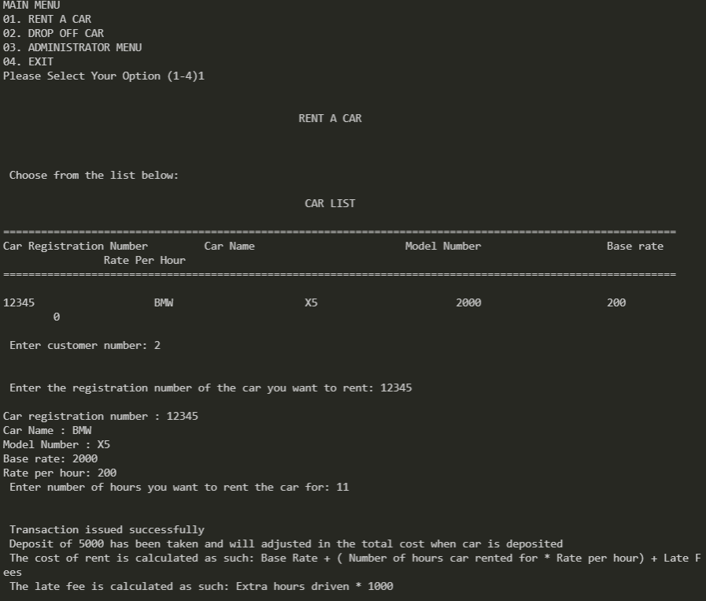

Slide 18
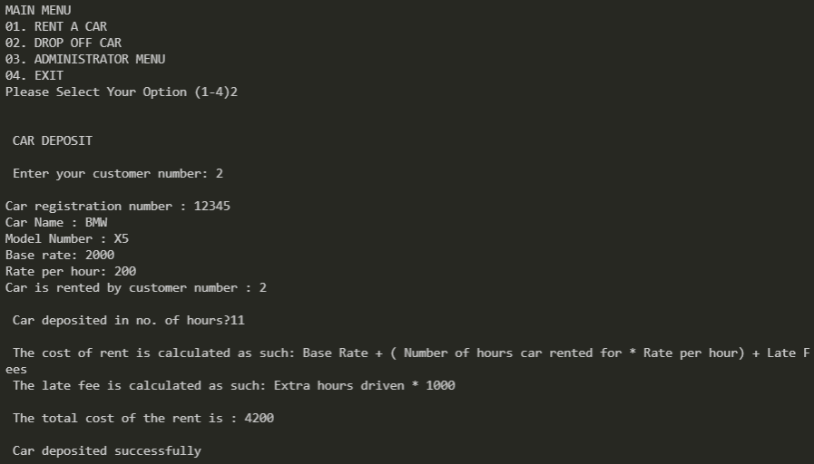

Slide 19
WORK DONE
TWO classes are used:
Car class: This class contains the following data members and member functions.
String cno- Car registration number
String cname - Car Name
String mno - Model Number
int baserate - Base rate for rent
int ratephr - Rate per hour for rent
String cuscno - Gets Customer Number of the customer renting the car
int token - To check if the car is currently rented or not
float hr - Gets the number of hours the car is rented
Customer class
String cusno - Customer number
String name - Customer name
String cuscno - Gets car number of the car rented by the customer
int token - To check if a car is currently rented by the customer

Slide 20
WORK DONE
Modules used:
void write_car() - To write a car record :
This modules will allow admin to record the car details.
The details of the car are as follows:
String cno- Car registration number
String cname - Car Name
String mno - Model Number
int baserate - Base rate for rent
int ratephr - Rate per hour for rent
String cuscno - Gets Customer Number of the customer renting the car
int token - To check if the car is currently rented or not
float hr - Gets the number of hours the car is rented
void write_customer() - To write a customer record:
This modules will allow admin to record the car details.
The details of the car are as follows:
String cusno - Customer number
String name - Customer name
String cuscno - Gets car number of the car rented by the customer
int token - To check if a car is currently rented by the customer

Slide 21
void display_spc(char n[]) - To display specific car record
This module will display specific a car record and will show if car is rented out or not
void display_spcus(char n[]) - To display specific customer record
This module will display specific a customer record and will show if customer has rented a car out or not
void modify_car() - To modify a specific car record
Will modify all details excpet “cusno”
void modify_customer() - To modify a specific customer record
Will modify all details excpet “cno”
void delete_customer() - To delete a specific customer record
Will delete a record when propmted with “cusno”
void delete_car() - To delete a specific car record from file
Will delete a record when prompted with “cno”
void display_allcus() - To display all customer records
Will display all relavent customer records
void display_allc() - To display all the car records
Will display all relavent car records
void car_issue() - To issue a car to a customer
Will rent out a car to customer only if they are not currently renting another car.
void car_deposit() - To deposit a car
Will allow customer to return a car
Deposit of 5000 has been taken and will adjusted in the total cost when car is deposited
The cost of rent is calculated as such: Base Rate + ( Number of hours car rented for * Rate per hour) + Late Fees
The late fee is calculated as such: Extra hours driven * 1000"
void admin_menu() - Admin menu
Contains all the above mentiontioned modules from 1-10

Slide 22
ADVANTAGES
This program has various features and advantages that come by it, which include:
The simple menu with clear instructions at each step would help the user navigate through the program with ease.
Any detail that may have an error while being inputted can be edited out easily at any point.
The program has been thoroughly tested so as to ensure that all possible inputs are accounted for, thereby never allowing the computer to reach an error state.
All the details of any car, or any customer is accessible quickly and easily through the ‘View all customers and ‘View all cars sections.
The data is stored in a compact nature, by the use of vectors.

Slide 23
SHORTCOMINGS
The program has the following shortcomings:
Doesn’t use file management, so the data that is input by the user isn’t stored after the application has been stopped, i.e. the data that was input in a previous runtime will not be stored for a later runtime.
The lack of a GUI results in a dull experience using the program.
Due to the use of vectors and matrices, the memory used isn’t optimal.
As the application isn’t password locked, there is no distinction between the users that run the program

